Slide 1


Internship Project Digital Lending & TechOps
FNBO Pagaya Process flow & AI-Powered Dashboard for Techops Ticket Tracking
Sambhav Singwi

Slide 2
Internship Overview
Week | Tasks | Learnings
1 | Got familiar with the Company’s organizational structure and about the business conducted in Digital lending. | Learned about the Digital lending and banking sector.
2 | Created Pagaya Process flow diagram for FNBO and did some research on Deferred Amortization schedule for loans. | Learned about Process flow diagrams and how Amortization schedules are created.
3 | Started analyzing the problem statement and created a basic Mail Tracker to track and store the emails in a excel sheet. | Learned about various ways to track emails and to manipulate excel sheet using python libraries.
4 | Researched on various types of AI models and integrated 2 AI models and a LLM for analysing the tickets. | Learned about NLP models and their types and how to use them for Intent based analysis.
5 | Understood the company Network limitations and the security protocols and found out alternatives for email tracking. | Learnt about the various ways to track Outlook mails and how to restrict them using security protocols.
6 | Created the Dashboard components and integrated the DL into the script. Worked on various edge cases revolving the DL and techops solutioning mails. | Learned about the working of techops solutioning and various scenarios revolving around it.
7 | Worked on Cloud access and Governance issues that might arise during production. | Learnt about the various security risks.
8 | Testing and finalizing features | Learnt about the the multiple edge cases involved when analyzing techops mails

Slide 3
The Problem
Problem Statement: Inefficiencies in Support Ticket Management
Manual Effort: Support emails from Digital Lending & Payments clients are tracked manually.
Time-Consuming and Error-Prone: Entering ticket details by hand slows down operations and increases errors.
Lack of Real-Time Visibility: Managers have no live insight into open tickets, current assignees, or ticket statuses.
Poor Management: Manual tracking relies on memory, leading to delays and some tickets being missed entirely.
Scalability Issues: Growing email volume exacerbates all these problems, making the existing system inefficient.
No Visibility
Manual & Error-Prone
No dashboard. Managers called team members for updates.
Every field filled by hand. Tickets missed, replies not logged.
No Classification
No Accountability
Emails not categorised. No way to track issue frequency or type.
No record of who was assigned, how long they took, or follow-up count.

Slide 4
Impact of Dashboard
0
< 1s
~7s
15s
Auto
Manual effort
per ticket
Issue Category
detection
AI resolution
check
Inbox poll
interval
Dashboard
refresh
BEFORE
Emails read manually. Details typed into a basic shared Excel sheet with no categories, no status tracking, no dashboard. Managers had no visibility. Missed emails meant missed tickets.
AFTER
Every email is automatically captured, classified by AI into one of the issue categories and logged to a shared Excel on SharePoint. A live dashboard shows ticket counts by Pending / Ongoing / Urgent / Resolved — updated automatically after every email, the number of tickets by category, by worth and by assignee along with a list of open tickets.

Slide 5
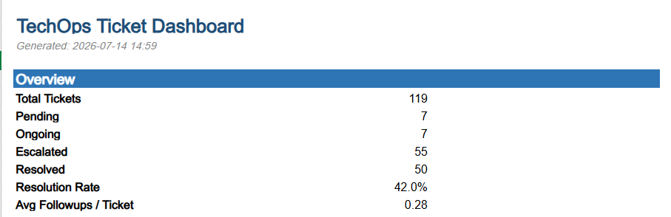
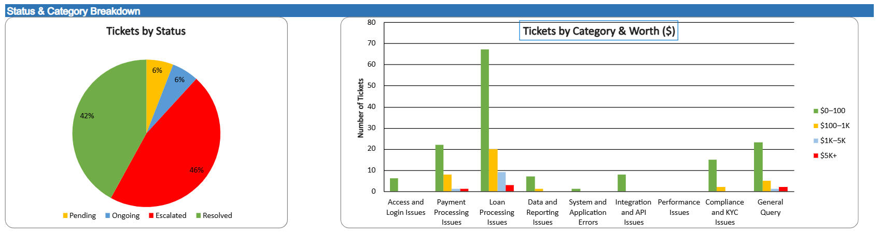
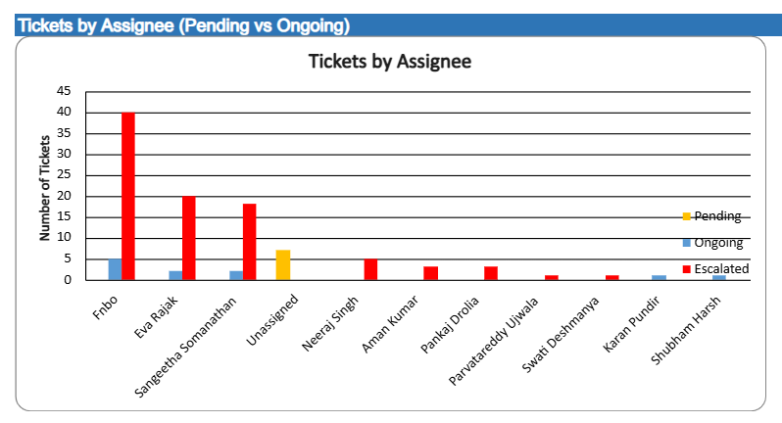
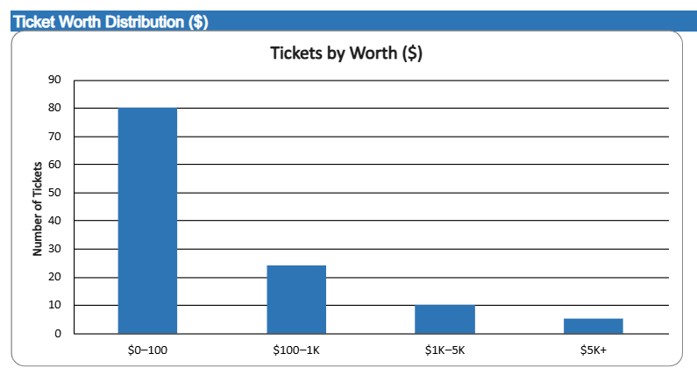
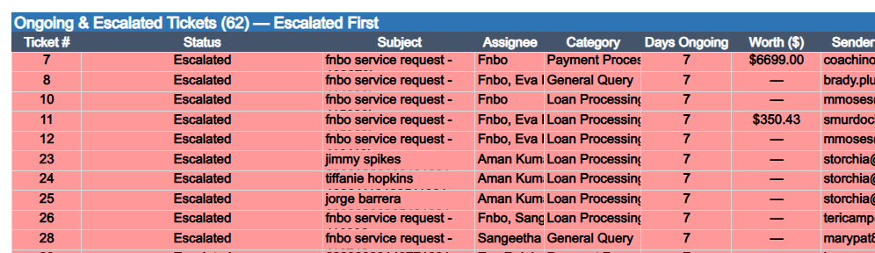
The Dashboard

Slide 6
The Solution : Using GenAI, LLM Models, Openpyxl & Pywin32**
Email Captured
AI Analysis
Excel Update
Team Access
Using Outlook COM Automation to attach to an ongoing outlook session and access the inbox to track the mails without the need of authentication.
Used a Sentence Embedding Model to identify the issue
Used a Zero-shot NER model to find Due date and Assignee
Used a Generative LLM for Sentimental Analysis of the conversation
New ticket or reply logged to SharePoint Excel. If a previous row exists with the same ticket id then updated otherwise, new ticket created and Dashboard rebuilt automatically.
Dashboard is on Sharepoint, accessible by all along with a trigger file to start or stop the script by anyone without actually having access to the code. Thus, ensuring no governance issues.
▶
▶
▶
** Technical details in appendix

Slide 7
Future Prospects
1
Microsoft Graph API on Azure
With IT admin consent, COM dependency removed. Script moves to an Azure Function — 24/7 cloud, no dedicated machine, no Outlook installation needed.
2
Power Automate Trigger
Replace tracker_control.txt with a Power Automate button — proper UI, Teams notification on completion, real-time run status.
3
Expanded AI Capabilities
Sentiment detection for frustrated clients, priority scoring, and auto-generated reply templates from Gemma based on ticket category.
Power BI Dashboard
4
Convert the Excel dashboard into a Power BI report — mobile access, real-time refresh, SLA alerts for high-worth unresolved tickets.

Slide 8
Scalability
Multi-Team Deployment
The script works on any Windows machine signed into any Outlook DL account. Another team — Payments Ops, Compliance, Risk — can deploy their own instance with zero code changes. Only the DL address needs updating.
Multi-Mailbox Support
Multiple instances can run simultaneously, each tracking a different DL and writing to its own SharePoint Excel. A manager-level aggregated dashboard across all teams is a natural extension.
Cloud-Ready Architecture
SharePoint integration is live. The Excel file syncs to the cloud in real time — any authorised user views the dashboard from any device.
Graph API Migration Path
The only constraint is the lack of IT admin consent for Microsoft Graph API. Once granted, the script moves to an Azure Function — cloud-hosted, 24/7, no dedicated hardware, triggered by a SharePoint list item.

Slide 9
APPENDIX
Technical Details
Architecture · AI Models · Key Decisions

Slide 10
Full Stack —How It Fits Together
EMAIL LAYER
STORAGE & CONTROL LAYER
pywin32 COM
Excel (openpyxl)
Connects to the already-running Outlook (Classic) desktop app via Windows COM automation. No credentials, no API, no network calls. Uses the already signed in Outlook session to read the inbox.
mail_tracker.xlsx — 15 columns including Worth ($) extracted by regex. Status: Pending / Ongoing / Urgent (auto after 3 days) / Resolved (auto after 7 days no client reply post employee response or if detected by LLM). Full conversation stored. Message-ID as primary thread key along with a subject check to identify the ticket.
DL Filter
SharePoint / OneDrive
Only emails having fnbo-l2-servicing@exlservice.com in To/CC/BCC field will be tracked. Uses exact address matching (split on separators) to prevent partial matches. Emails not passing this filter are not analyzed and are ignored.
OUTPUT_FILE points to the OneDrive sync path. Script writes locally — OneDrive syncs to SharePoint within seconds. Any authorised team member views the dashboard from any device. Version history built in.
Mid-Chain Parser
Governance Trigger
For cases when the client didn’t sent mail to the fnbo-l2-servicing@exlservice and directly contacted an employee, the employee while replying can just tag the DL in CC and parse_quoted_chain() finds From:/Sent:/Subject: blocks directly in the email body regardless of Outlook version or quote format. Reconstructs full history, extracts original sender, timestamp, followup count.
tracker_control.txt on SharePoint — team writes START/STOP/IDLE (case-insensitive). Script checks every 5s while waiting, every 15s while running. After STOP: dashboard updated, file reset to IDLE, script returns to wait state. Only Ctrl+C fully exits. This way the script can’t be tampered with to view personal emails.
POLL_INTERVAL=15s → DL filter → AI pipeline → Excel write → Dashboard rebuild → OneDrive sync → SharePoint

Slide 11
AI Models
~430MB
~0.4s per ticket
Pre-encodes 9 descriptive category label sentences at startup (not at call time)
WHY
BGE — Category Detection
Converts the first email body to a vector embedding
Tested 6 approaches on different models on 26 cases. BGE margin-based gave 94% accuracy with focused 1-2 labels per ticket.
Computes cosine similarity against all 9 label embeddings
BAAI/bge-base-en-v1.5
Margin-based selection: top score always included, plus any within 0.05 of it
Sentence Embedding Model
Pre-check: pure question words + no problem words → General Query (no model call needed)
~170MB
~0.04s per call
Zero-shot named entity recognition — no fine-tuning needed
WHY
GLiNER — Due Date & Assignee
Due dates: scans words for date/time/duration entities, threshold 0.3
Lightweight (170MB), dual-purpose (dates + names), threshold-controllable to reduce false positives. Faster than running an LLM for structured extraction.
Only accepts dates that appear in a deadline-context sentence (words like 'by', 'due', 'before')
urchade/gliner_small-v2.1
Assignee: scans for person name entities — only accepted if sender email is @exlservice.com
Zero-shot NER Model
Special cases handled manually: ASAP, URGENT, EOD, EOW, weekend
~800MB
~7s per call
Full conversation log passed (newest first) with original sender identified
WHY
Gemma 3 1B — Resolution Check
Prompt distinguishes: explicit fix OR clear action taken = YES; only acknowledgement = NO
Tried rule-based (failed), transformers float16 (34s, too slow), Qwen3-0.6B and Qwen2.5-1.5B (accuracy unacceptable). Gemma 3 1B gave correct YES/NO with 7s latency.
gemma3:1b via local Ollama (Q4_K_M GGUF)
Handles implicit resolutions: 'please check now', 'we have made the change', 'it should work'
Generative LLM for Sentiment Analysis
Temperature 0.1 for near-deterministic output

Slide 12
Decisions Made
How to read Outlook emails?
✗ Tried: IMAP (port 993 blocked), Microsoft Graph API (admin consent not available)
⚠ Limit: Requires Windows + Outlook (Classic) open and signed in on dedicated machine.
✓ Chose: pywin32 COM — attaches to running Outlook session via Windows COM. No credentials, no admin consent, no network calls.
How to categorise emails?
✗ Tried: 6 approaches tested on 26 cases: hard threshold (over-included 7-9 cats), mpnet (lower accuracy), Gemma+BGE pipeline (too slow at 7s), adaptive margin (gamed metric)
⚠ Limit: 150-word input cap to stay within BGE's token limit. Runs once per ticket, never on replies.
✓ Chose: BGE margin-based: top score always included, plus any within 0.05. 94% accuracy, 1-2 focused labels, ~0.04s per ticket. Pre-check for pure queries avoids model call entirely.
How to check if a ticket is resolved?
⚠ Gemma only called when non-sender replies (minimises LLM calls). Auto-resolve runs every 15s poll cycle — zero LLM cost. Escalation threshold: 3 days. Auto-resolve threshold: 7 days. Both configurable constants.
✗ Rule-based keywords (couldn't distinguish acknowledged vs fixed), transformers float16 (34s, too slow), Qwen3-0.6B (failed YES cases), Qwen2.5-1.5B (same problem).
✓ Chose: Gemma 3 1B via local GGUF import (ollama create). ~7s, correct YES/NO including implicit resolutions. Prompt explicitly handles 'please check now', 'we made the change' as resolved indicators.
How to give team control without exposing code?
⚠ Limit: Requires OneDrive sync to be active on the dedicated machine.
✗ Tried: Flask server (firewall blocked port 5000 between VPN clients), ngrok (SSL intercepted by corporate network)
✓ Chose: tracker_control.txt on SharePoint. Team edits one word (START/STOP). OneDrive syncs to dedicated machine in seconds. Script checks the file every 15s.

Slide 13
Thank You
Questions & Discussion
Script: dynamic_dashboard.py
Output: mail_tracker.xlsx on SharePoint
Models: GLiNER · BGE · Gemma 3 1B (local GGUF)
Trigger: tracker_control.txt on SharePoint
Sambhav Singwi
DE & AI Intern — EXL Service
Notes:
Leave time for questions.

